Slide 1

Event related potentials & Statistics
Franz Hell
Introduction to Electrophysiology
December, 2015

Slide 2
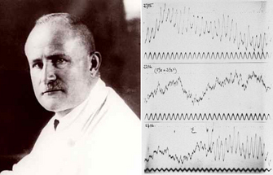
EEG/ERP History
1929: Hans Berger – initial observations of spontaneous slow and rhythmic brain waves
1939: Davis et al.: first sensory event-related potentials (ERP)
1965: Sutton et al. P300 in oddball paradigm

Slide 3
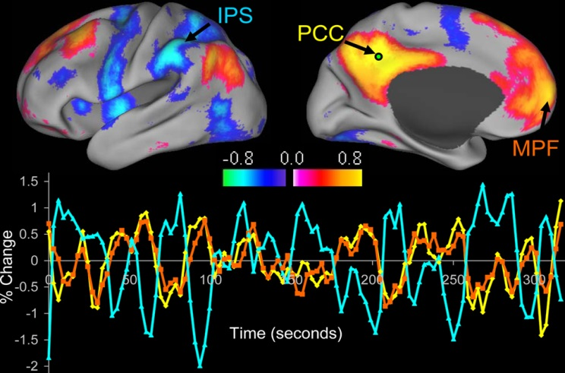
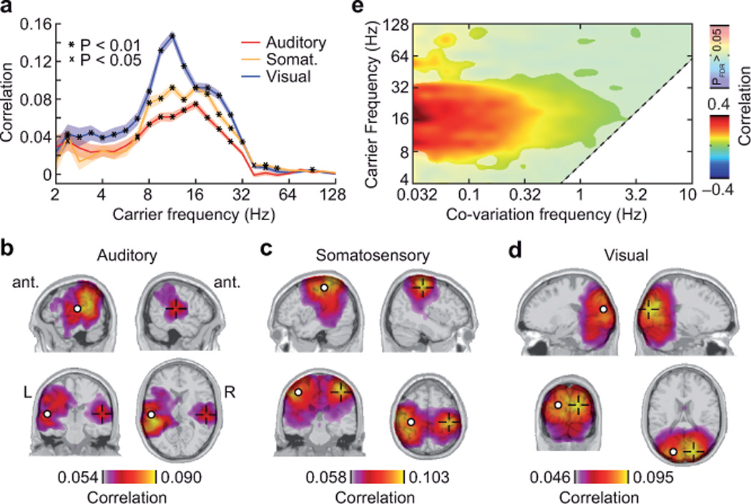
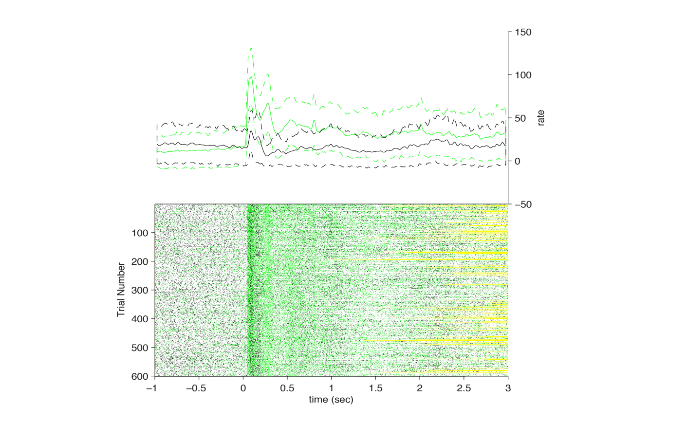
Activity in the Brain
„Resting“ activity:
e.g. poisson-like spiking profiles of neurons at rest
spontaneous activity not random, see e.g. fMRI , M/EEG resting state networks (Hipp, Siegel, Biswal, Raichle, Buckner et al.)
Event-related activity: changes in the brain activity in relation to specific events such as internal or external stimuli, events, stimulation or movement.

Slide 4
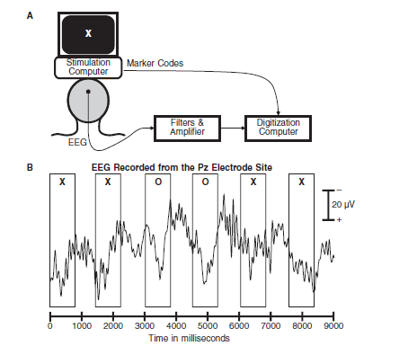
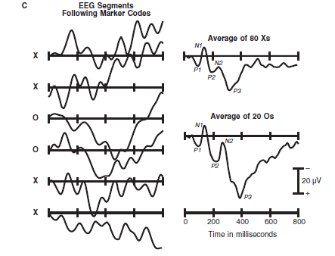
From raw EEG to ERPs
ERP Components:
P = Positive
N = Negative
P1 = P100
P2 = P200
P3 = P300
etc.
Notes:
ERP components have labels like P1 and N1 refer to polarity and position in the waveform. These labels are NOT linked to the nature of the underlying brain activity!
Luck(2005)

Slide 5
Different ERP Components
Very early components:
  Auditory brainstem response (ABR) (10-50ms)
  C1 (V1 at 40-60ms)
  P1 (e.g. frontocentral auditory P1 at 50ms, lateral-occipital visual P1 at 60-100ms))
N1
  e.g. auditory & visual N1 at various sites at 100-150ms
P2
  Larger for targets, various with stimulus probability
N2
  Mismatch Negativity (MMN)
  negative deflection at 160ms -220ms at frontocentral sites
  N2pc
P3
  Various subforms (P3a, P3b), varies with e.g. target probability
N400
  Language related, e.g. in response to violations of semantic expectancy
Error related negativity (ERN)
  negative deflection at frontocentral electrodes after erroneous response
Response-Related ERP Components
  Bereitschaftspotential (BP) or readiness potential (RP): fronto-central negativity preceeding response
  Lateralized Rediness potential (LRP)

Slide 6
Different ERP Components
Very early components:
  Auditory brainstem response (ABR) (10-50ms)
  C1 (V1 at 40-60ms)
  P1 (e.g. frontocentral auditory P1 at 50ms, lateral-occipital visual P1 at 60-100ms))
N1
  e.g. auditory & visual N1 at various sites at 100-150ms
P2
  Larger for targets, various with stimulus probability
N2
  Mismatch Negativity (MMN)
  negative deflection at 160ms -220ms at frontocentral sites
  N2pc
P3
  Various subforms (P3a, P3b), varies with e.g. target probability
N400
  Language related, e.g. in response to violations of semantic expectancy
Error related negativity (ERN)
  negative deflection at frontocentral electrodes after erroneous response
Response-Related ERP Components
  Bereitschaftspotential (BP) or readiness potential (RP): fronto-central negativity preceeding response
  Lateralized Rediness potential (LRP)

Slide 7
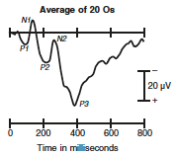
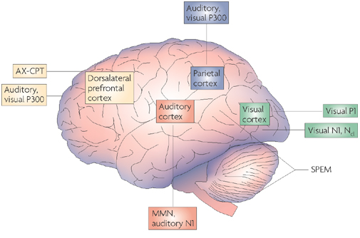
ERP Components – P1
P1:
Sensory peak, elicited by visual stimuli no matter which task is used
strongly influenced by stimulus parameters (luminance)
Onset: 60-90 ms, peak:100-130ms
Latency varies with contrast
Early portion may come from middle occipital gyrus, late portion from fusiform gyrus
Luck, 2005
Notes:
Also called continuuous performance task

Slide 8
ERP Components – P3 group
P3:
Depends on which task is performed
no clear consensus about what neural or cognitive process the P3 wave reflects. (‘context-updating’)
P3 amplitude gets larger as target probability gets smaller.
Also local probability matters, because the P3 wave elicited by a target becomes larger when it has been preceded by more and more nontargets.
Luck, 2005
Notes:
know a great deal about the effects
of various manipulations on P3 amplitude and latency, but there is
Moreover, it is the probability of the
task-defined stimulus class that matters, not the probability of the
physical stimulus. For example, if subjects are asked to press a button
when detecting male names embedded in a sequence containing
male and female names, with each individual name occurring
only once, the amplitude of the P3 wave will depend on the relative
proportions of male and female names in the sequence (see
Kutas, McCarthy, & Donchin, 1977). Similarly, if the target is the
letter E, occurring on 10 percent of trials, and the nontargets are
selected at random from the other letters of the alphabet, the target
will elicit a very large P3 wave even though the target letter is
approximately four times more probable than any individual nontarget
letter (see Vogel, Luck, & Shapiro, 1998).
e.g. here much larger for the rare O then for the frequent X stimuli

Slide 9
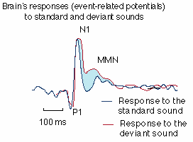
ERP Components –Mismatch Negativity (MMN)
observed when subjects are exposed to a repetitive train of identical stimuli with occasional mismatching stimuli
negative-going wave that is largest at central midline scalp sites and typically peaks between 160 and 220 ms.
Several other components are sensitive to mismatches if they are task-relevant, but the MMN is observed even if subjects are not using the stimulus stream for a task
thought to reflect a fairly automatic process that compares incoming stimuli to a sensory memory trace of preceding stimuli.
Notes:
However, the MMN can be eliminated for stimuli presented in one ear if the subjects focus attention very strongly on a competing sequence of stimuli in the other.

Slide 10
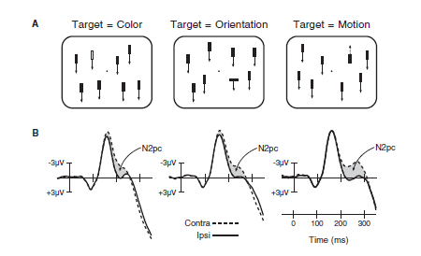
N2pc - a lateralized component

Slide 11
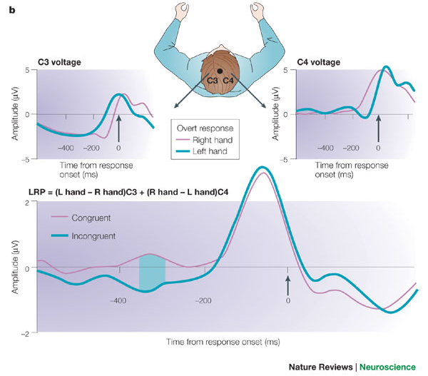
The lateralized readiness potential LRP

Slide 12
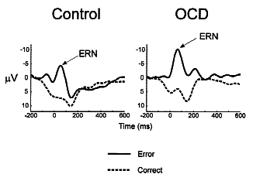
ERP Components –Error-related negativity (ERN)
Can be elicited by
Being aware of an error
negative feedback following an incorrect response
- observing someone else making
an incorrect response
Most investigators believe that the ERN reflects the activity of a system that either monitors responses or is sensitive to conflict between intended and actual responses.
Source could be ACC.

Slide 13
The forward and the inverse problem

Slide 14
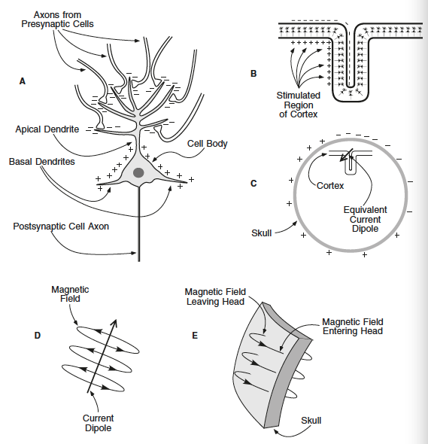
What is an ERP? - Postsynaptic Potential
If an excitatory neurotransmitter is released at the apical dentrides:
current will flow from extracellular space into the cell, yielding a net negativity on the outside in the region of the dentrides.
Current will also flow out of the cell body and basal dentrides yielding a net positivity in this area
Cortical pyramidal cell
Luck, 2005
Notes:
Action potential duration: 1ms

Slide 15
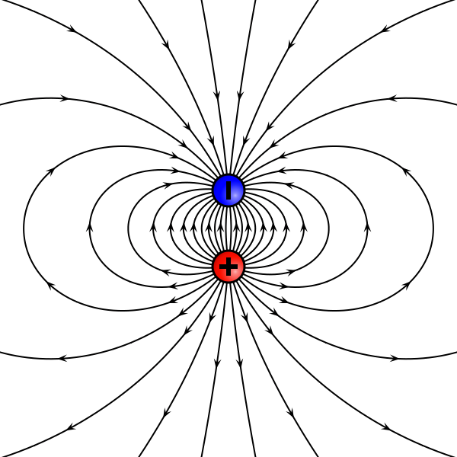
Best guess of a biophysical event that gives rise to a scalp ERP
This creates a tiny dipole
dur: 10-100ms
location: largely dentrides & cell body
delay: occur instantaneously and do not travel down the axon
size: Can summate under certain conditions rather then cancel each other out and then be recorded at great distance (scalp)
Luck, 2005

Slide 16
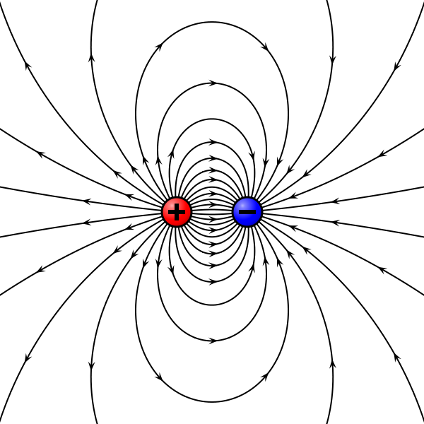
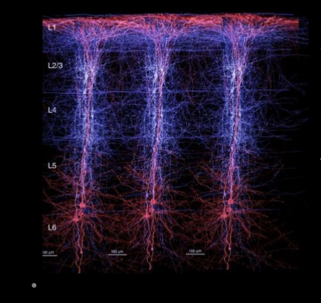
Best guess of a biophysical event that gives rise to a scalp ERP
The dipole of a single neuron is tiny
But under certain conditions the dipoles from many neurons will summate
1. occur approximately at the same time across 1000 – 1000 000 neurons
2. be spatially aligned
3. receive all excitatory or all inhibitory input
This is most likely in cortical pyramidal cells, which are aligned perpendicular to the surface of the cortex
Luck, 2005

Slide 17
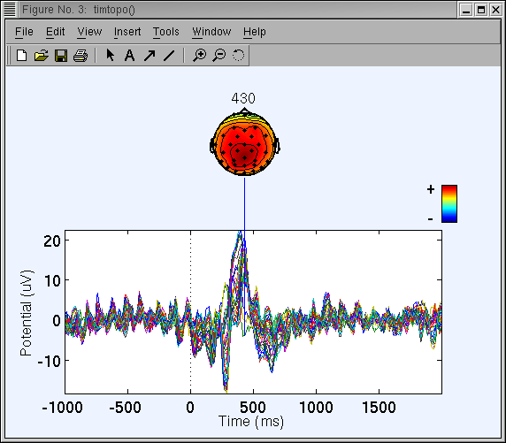
The ERP at the sensor level
Notes:
Volume conduction

Slide 18
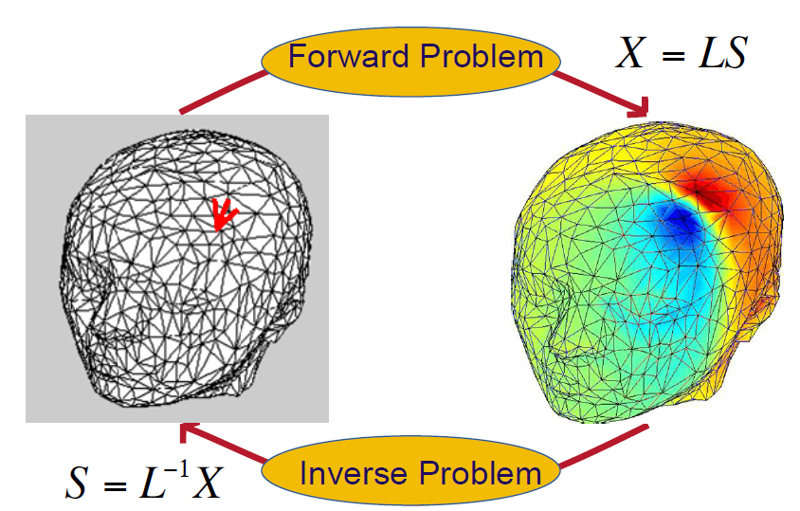
The forward and inverse problem
X = LS + n X: scalp recorded potentials
S: current density vector L: transfer matrix ‘the head volume conductor model’
solutions: source reconstruction algorithms, current source density maps, beamforming, ica, spatial filter e.g. laplacian...
Notes:
, solution: source reconstruction algorithms, current source density maps, beamforming, ica, spatial filter e.g. laplacian

Slide 19
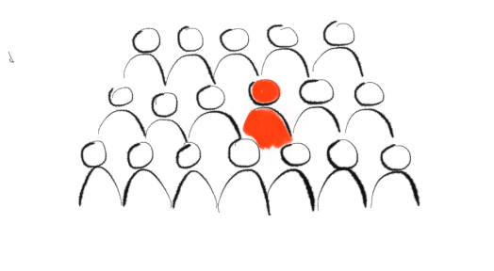
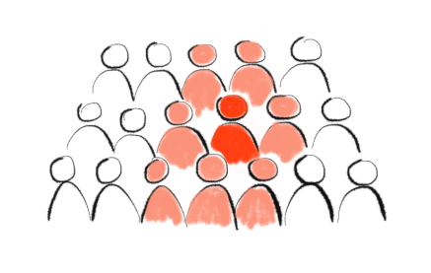
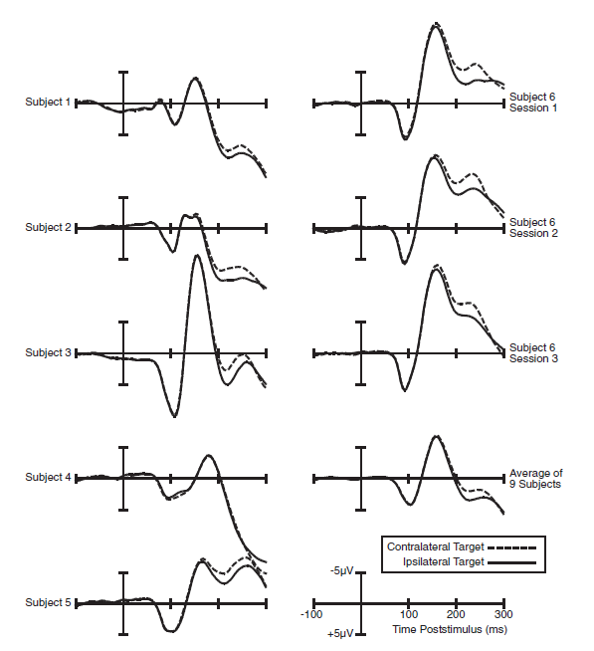
Reliability of ERP waveforms
Averaging changes your data
Rule 5. Never assume that an averaged ERP waveform accurately
represents the individual waveforms that were averaged together.
In particular, the onset and offset times in the averaged waveform
will represent the earliest onsets and latest offsets from the individual
trials or individual subjects that contribute to the average.

Slide 20
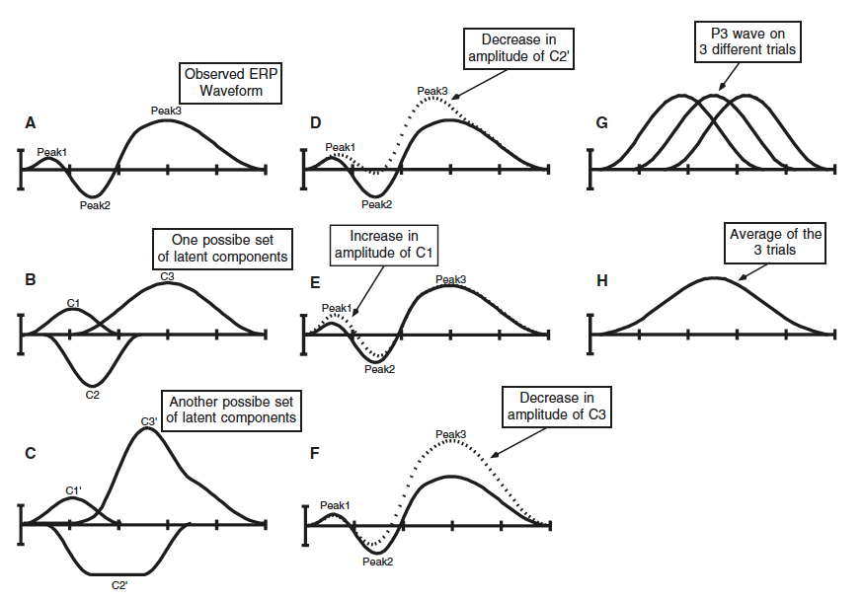
Voltage Peaks are not special
Rule 1. It doesn’t make sense to measure
peak amplitude and peak latency to measure
the magnitude and timing of ERP components.
Luck, 2005

Slide 21
Peak Shapes Are not the Same as Component Shapes
Rule 2. It is impossible to estimate the time course or peak latency of a latent ERP component by looking at a single ERP waveform.
Rule 3. It is dangerous to compare an experimental effect (i.e.,the difference between two ERP waveforms) with the raw ERP waveforms.
Luck, 2005

Slide 22
Peak amplitudes are different from component sizes…
Rule 4. Differences in peak amplitude do not necessarily correspond with differences in component size, and differences in peak latency do not necessarily correspond with changes in component timing.
One Solution: Residue Iteration Decomposition (RIDE)
A Method for the Decomposition, Reconstruction, and Single Trial Analysis of Event Related Potentials
Luck, 2005
Notes:
RIDE is a method for decomposing and reconstructing ERP and analyzing the trial-to-trial variability information of ERP. It was initiated and developed by Guang Ouyang, Changsong Zhou and Werner Sommer on 2011.
The main utility of RIDE is to overcome the limitation of conventional stimulus-locked average ERP that the waveform is blurred by trial-to-trial latency variability. This limitation leads to many problems such as distortion of ERP waveform and attenuation of ERP effects, and so on.

Slide 23
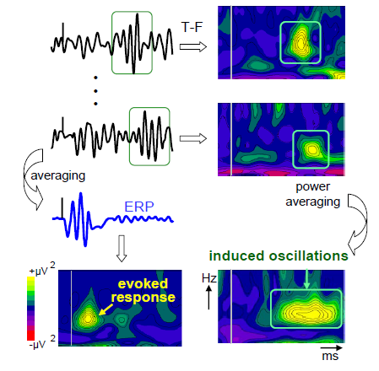
Event-related activity: evoked and induced activity
induced
evoked

Slide 24
From the raw EEG to the event-related potential: processing steps
Preprocessing
  Re-referencing
  Filtering (e.g. Low-pass, Notch-Filter, High-pass)
  Removing DC Offset
  Epoching
  Artifact rejection
Averaging
Statistical evaluation

Slide 25
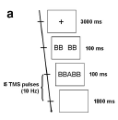
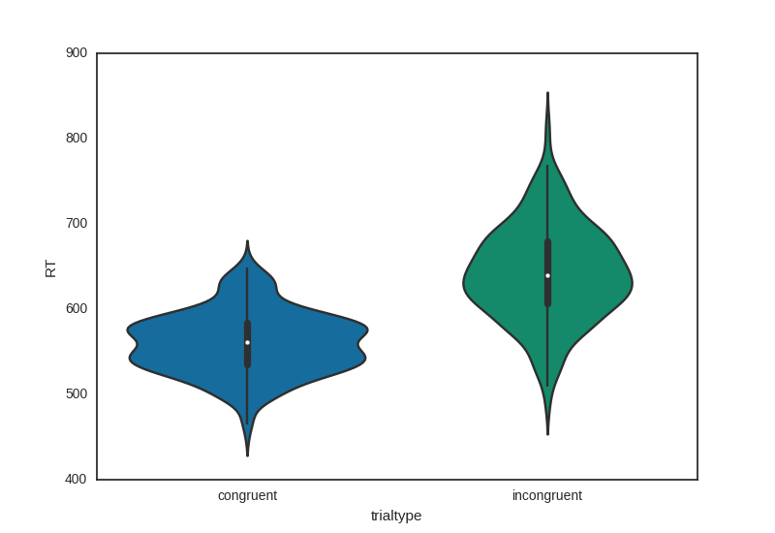
Paradigm: Cued flanker task
2 response categories:
target vowel or consonant?
Answer with left/right hand.
3 conditions:
Stimulus congruent, reponse congruent:
BB followed by B
Stimulus incongruent, response congruent:
BB followed by K
Stimulus incongruent, response incongruent:
BB followed by A/E

Slide 26
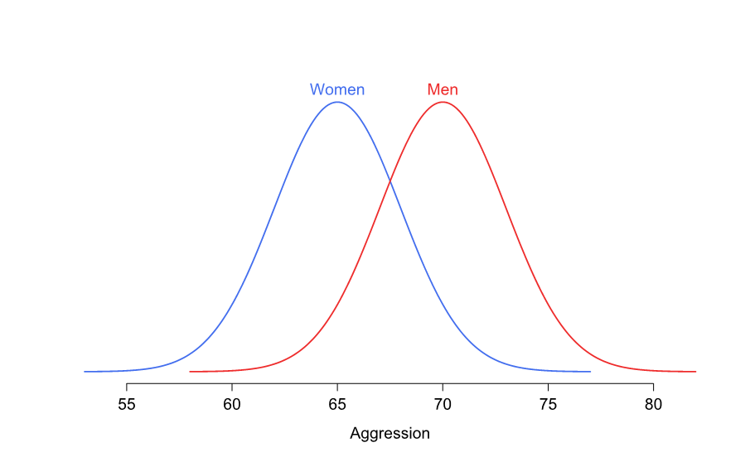

Slide 27
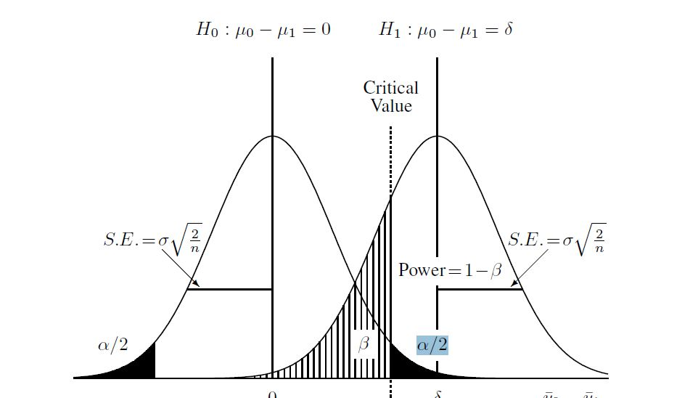



Slide 28
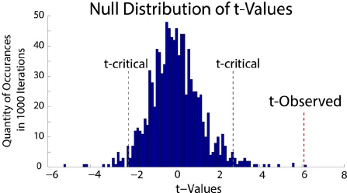

Slide 29
